Slide 1
Dr. Delaunay or: How I Learned to Stop Worrying and Love Triangulations
Saip-Can Hasbay (01428723)
Supervisor: David Hahn
Research Unit of Computer Graphics
Institute of Visual Computing & Human-Centered Technology
TU Wien, Austria

Slide 2
Outline
Delaunay Triangulations
Background and Motivation for Tetrahedralizations
TetWild – Tetrahedral Meshing in the Wild, Yixin Hu et al. 2018
Constrained Delaunay Tetrahedrization*, Diazzi et al. 2023

Slide 3
Delaunay Triangulations (DT) in 2D
test1234

Slide 4
Constrained or Conforming DT in 2D

Slide 5
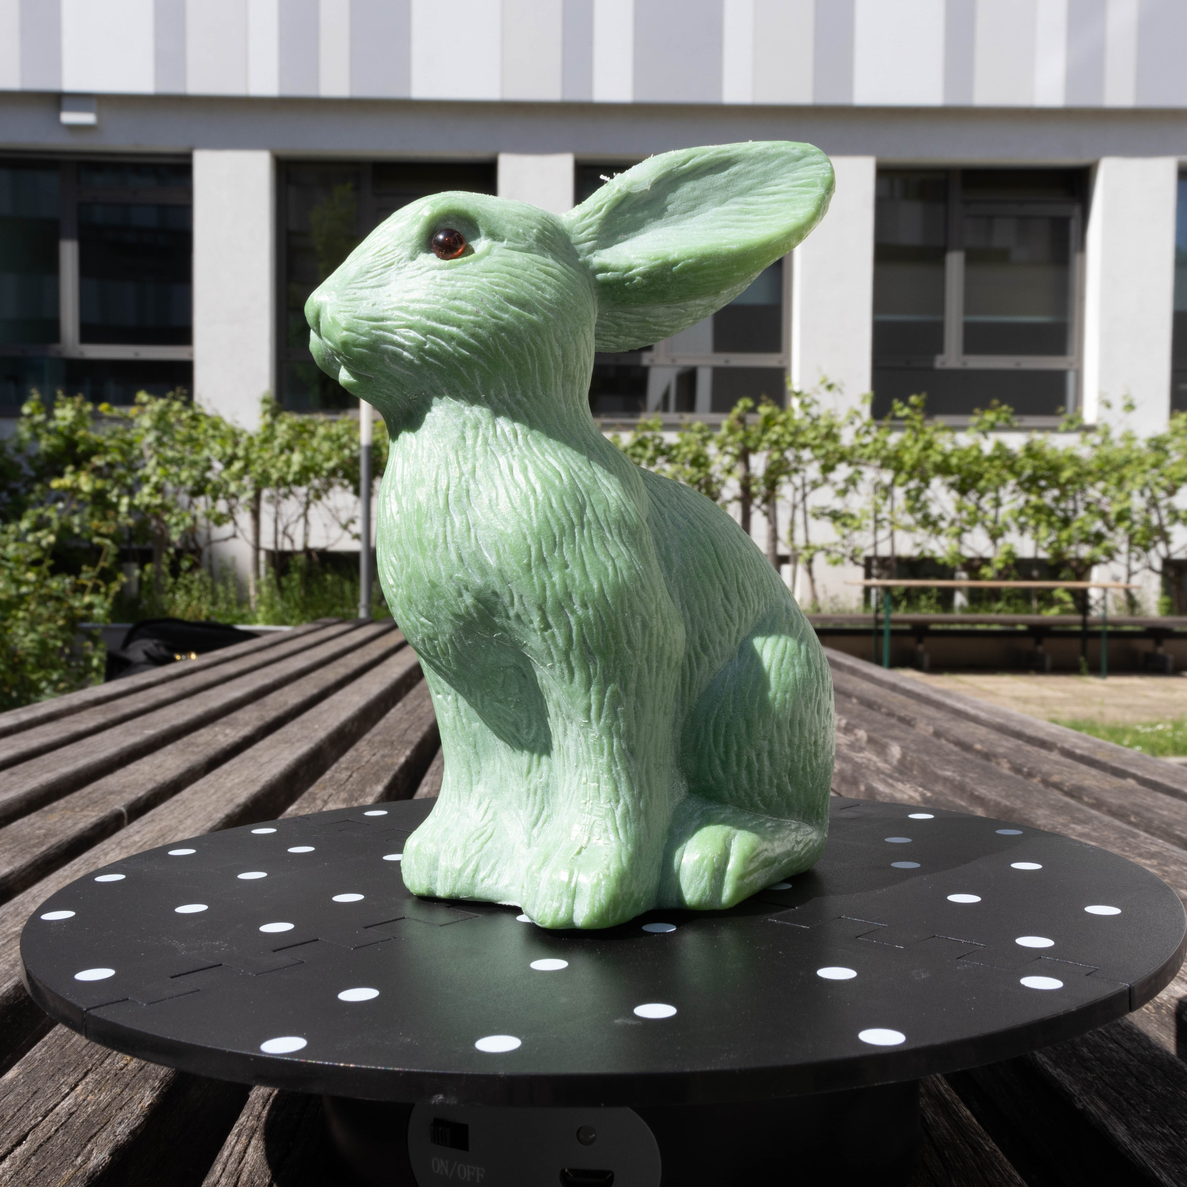
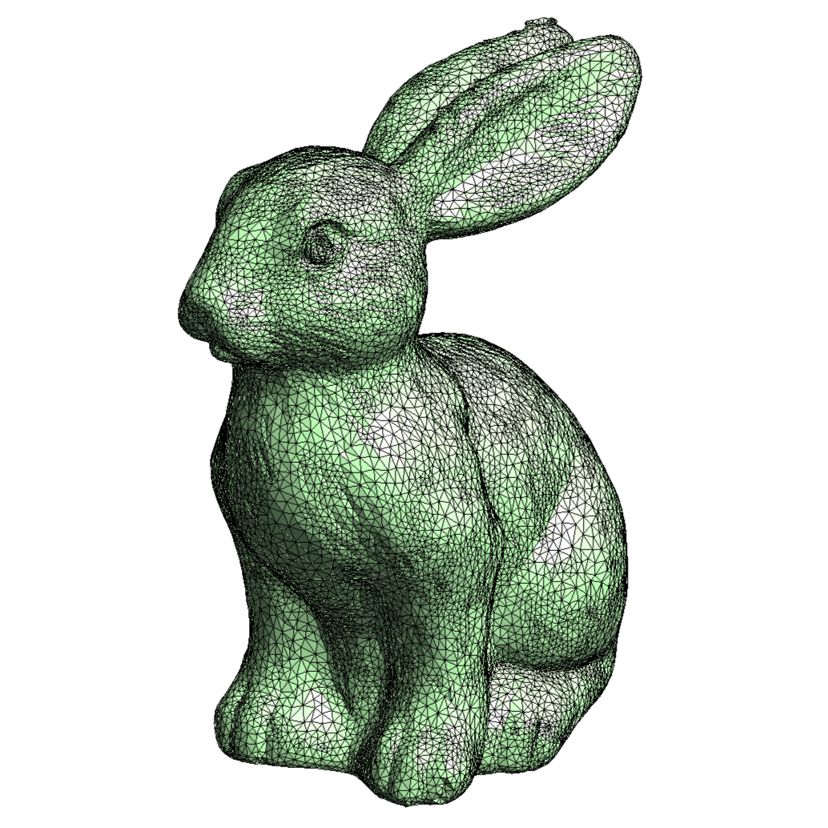
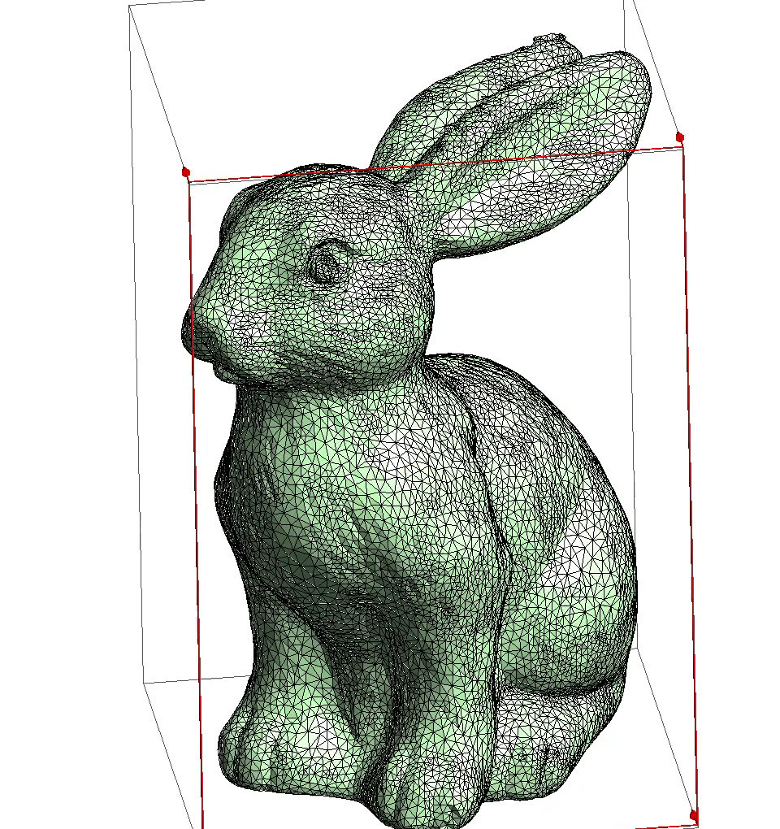
What is a tetrahedralization?
A bunny found in the wild
Surface Representation
Volumetric Representation
Notes:
It is a volumetric discretization method.
Input: usually takes 3D shape
Uses tetrahedra to fill the shapes interior
Output: volumetric tetrahedral mesh that conforms to the input surface.

Slide 6
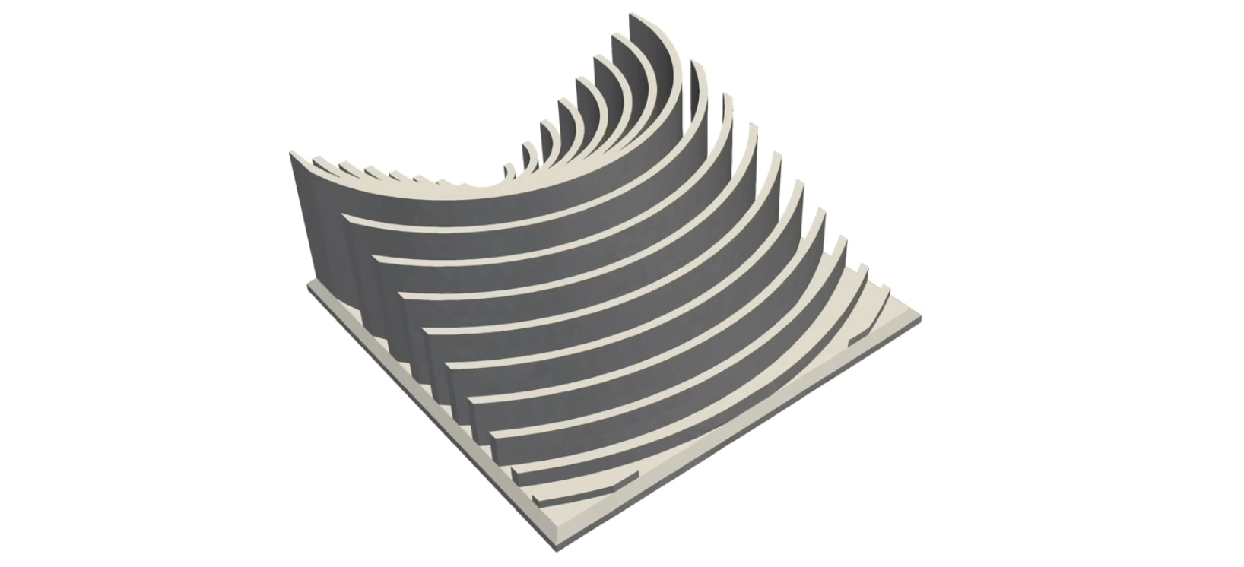
But… Why?
Taken from Fast tetrahedral meshing in the wild
Hu et al. 2020, SIGGRAPH 2020
Notes:
Has a lot of applications. E.g., physical simulation, rendering, interpolation

Slide 7
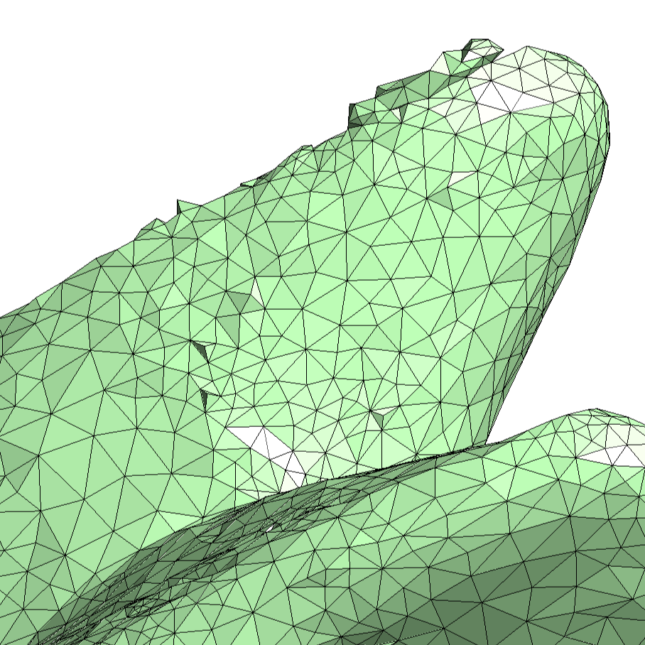
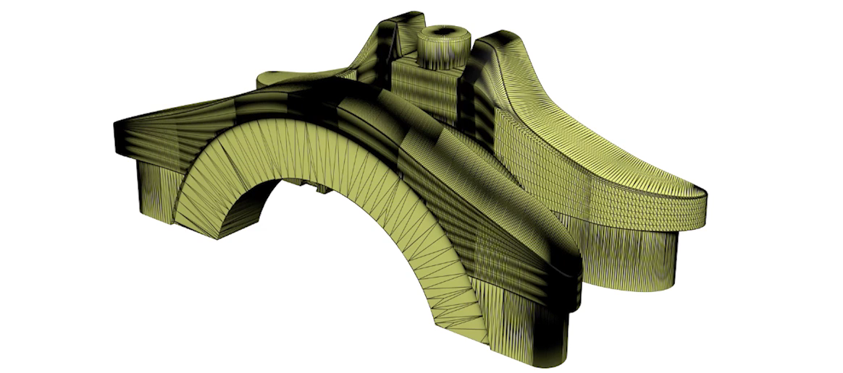
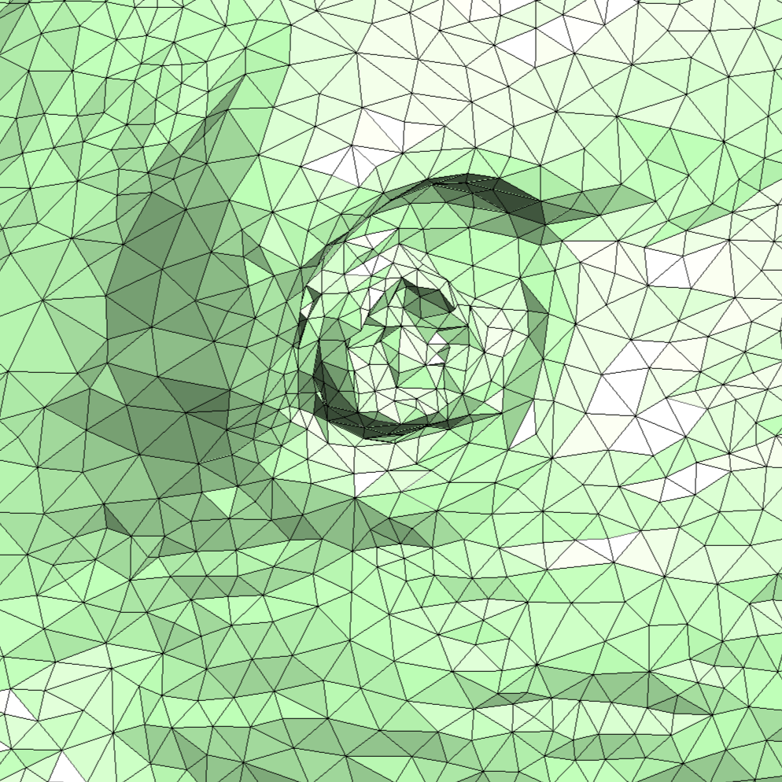
Difficulties
TetWild Hu et al. 2018, SIGGRAPH 2018
Notes:
Overall, this is a hard problem.
A lot of work has been done already.
1. Input mesh that might be obtained from real world can be far from what the algorithm expects.
- self intersections
- small gaps
So there is no robust and automatic way to clean up the surface. Requires manual intervention.
Fig. Contains dense needle like triangles.
When you zoom in: strange regions
- self-intersections
- it is just garbage: or triangle soup
There are a bunch of models like this in the wild.
Interesting dataset: Thingi10k. Contains real world surface meshes.
Hu mentions they are ideal for 3d printing, but they are horrible as surface mesh.
When they initially tried to tetrahedralize them, they encountered a problem.
There was no method to robustly tetmesh all of them.
Led to crashes, or outputted something completely different from the input.

Slide 8
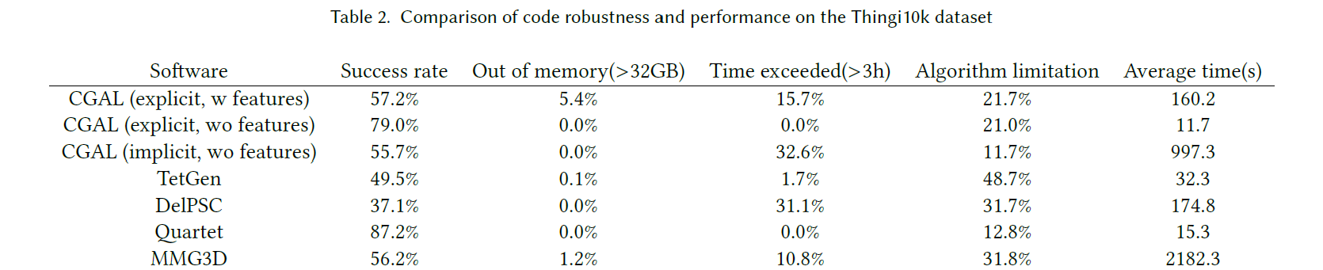
Is there a robust method?
TetWild Hu et al. 2018, SIGGRAPH 2018
Notes:
Is it possible to have a method to robustly tetrahedralize a mesh while preserve the input surface as much as possible?
For example Cgal, tetgen, DelPSC, Quartet and MMG3d.
Results are not bad as they are not designed strictly for this purpose.
Quartet has high success rate, but some of the results lose feautres -> not what we desire.
Also 87.5 is not good enough.
Basically, there are methods that are robust like quartet but are not faithful to the input mesh and vice versa.
There are mathematical proofs of robustness of existing methods.
But they are in infinite precision, when they are implemented in floating points, they can fail due to numerical issues.

Slide 9
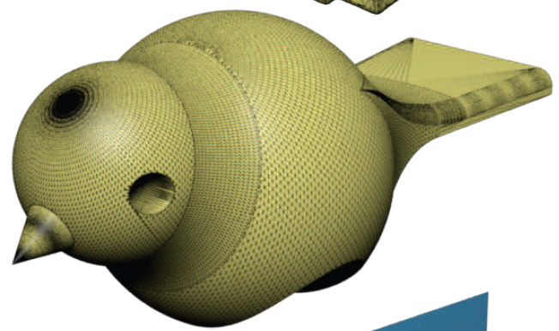
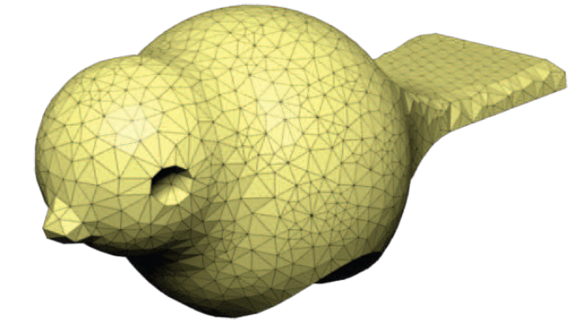
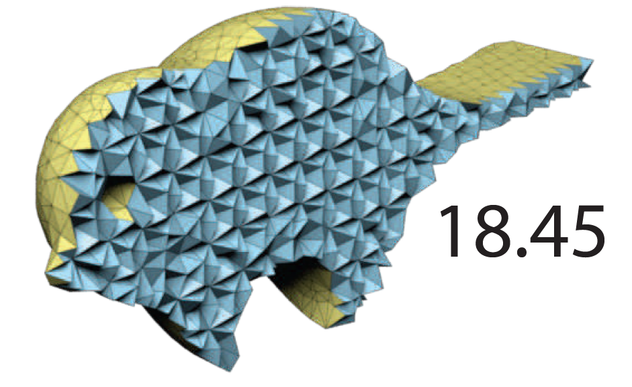
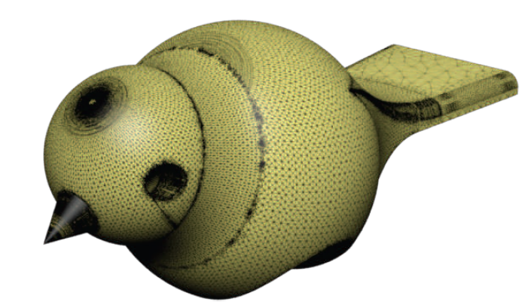
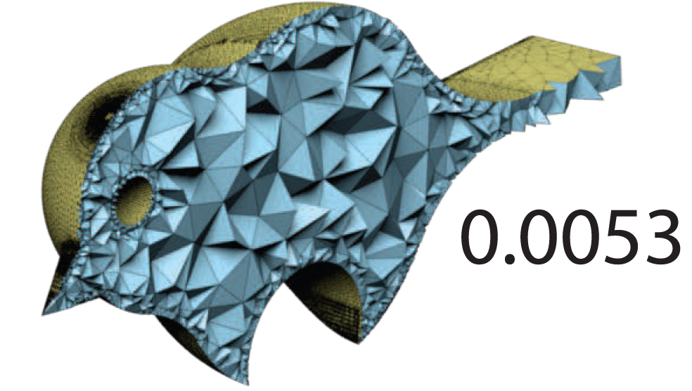
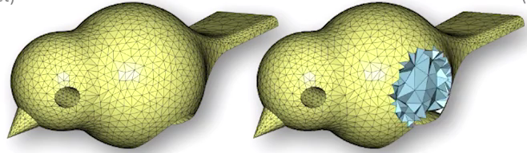
TetWild, Hu et al. 2018
Input
Robustness
Faithfulness
Generated by
Quartet
Generated by
Tetgen
Generated by
TetWild
Notes:
Hu proposes a new method which is:
1. closed under rationals.
2. approximate input surface within an envelope (controlled by a parameter, envelope size)
Why envelope?
If input contains smalls gaps or tiny creases, as long as they stay inside an envelope, they can all be resolved in the output.

Slide 10
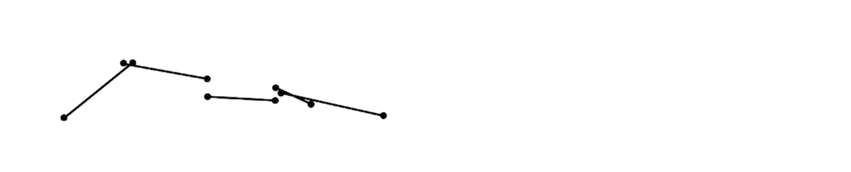
TetWild: Hu et al. 2018
Method
Closed under rationals
Approximate input surface within an envelope.
Why envelope?
Notes:
Input: a triangle soup that forms the surface of a 3d shape.
- No assumption about the input.
Out: approx. constrained tetrahedral mesh within an envelope.
- method is able to cleanup imperfect regions and produce high quality out.

Slide 11
TetWild: Input & Output
Input: Triangle mesh
No assumption about the input.
Output: Approximately constrained tetrahedral mesh.
Manages to deal with imperfect regions.
Notes:
Input: a triangle soup that forms the surface of a 3d shape.
- No assumption about the input.
Out: approx. constrained tetrahedral mesh within an envelope.
- method is able to cleanup imperfect regions and produce high quality out.

Slide 12
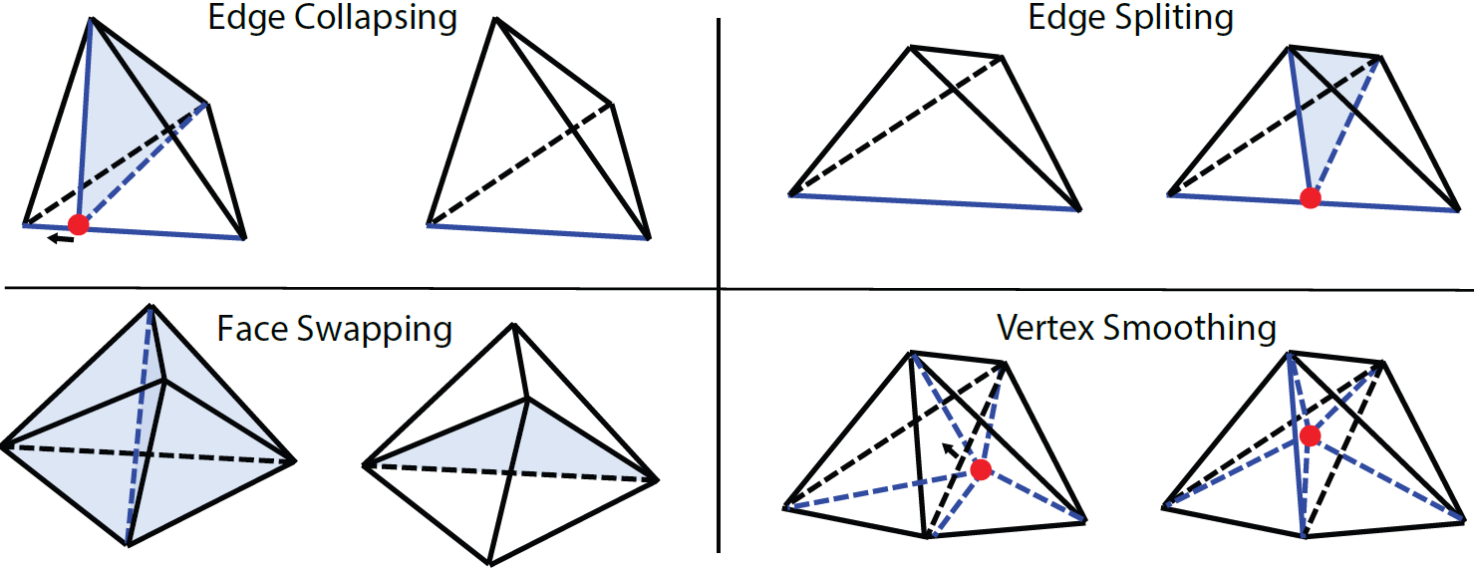
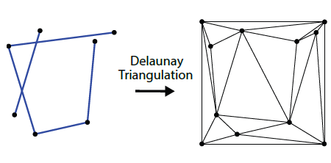
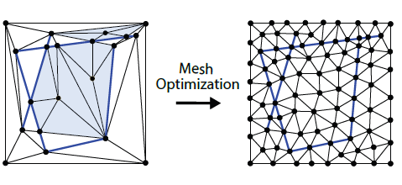
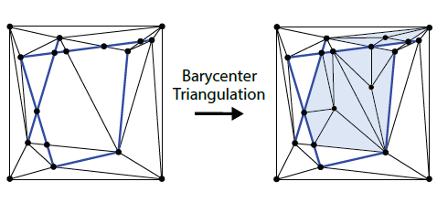
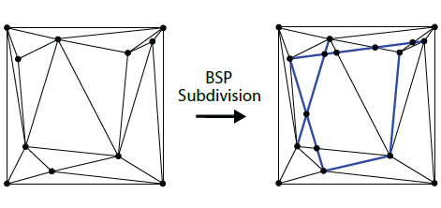
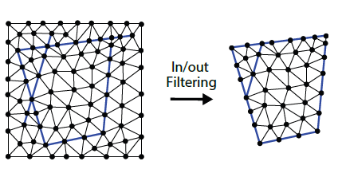
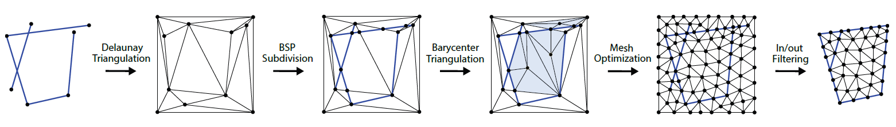
TetWild: Pipeline in 2D
Phase 1
Phase 2
Notes:
Bunch of ssegments as inputs.
Everythin in exact rationals.
CGAL represents numbers in fractions.
The numerator and denominator could be large integers.
1. Delaunay triangulation. Input is put inside a box slighty larger than the input. Partitions the box into convex cells.
> DT or DTET is known to be robust. But, does not conform to input boundary.
2. BSP Subdivision. For preserving the input boundary, and resolving self-intersections. First a BSP tree using the triangles we got in the first step as the initial tree nodes. The line of the input-segment to subdivide the bsp cells. Out: a polygonal mesh.
3. Triangulate the mesh. Since all BSP cells are convex, the easist way to add vertices in the centroid of the polygonal cells then connect it to the edges to form triangles. With this step the first stage is finished. Out: valid triangle mesh in rationals.
Valid: no inversion or self-intersections. Input boundary is preserved.
But: mesh could be in low quality. Output contains no inversions in exact rationals but if converted to floating point, might contains inversions.
4. To improve its quality we need mesh optimization. AS the quality improves we could gradually we can convert to floating points. They use four local operations for opt:
- edge splitting
- edge collapsing
- face swapping
- vertex smoothing
Details in report.
Edge collapse: one vertex to another. To accept the operations: check if the quality is improved. The quality measure they use is conformal amips 3d energy. If the local energy increase the local quality decrease: reject operation.
This could introduce inversions in the mesh. Need inversion check.
Envelope check for making sure that the vertex does not exceed the boundary.
If all checks pass, the operation is accepted.
5. In/out filtering: Remove all element outside the boundary. They use generalized winding number (Jacobson. ps test of time award at this siggraph). Compute winding number for centroid of each cell. If winding number is larger than 0.5, then it means they are outside and they delete them.
Pipeline is finished and we get a valid high quality mesh in floating points.

Slide 13
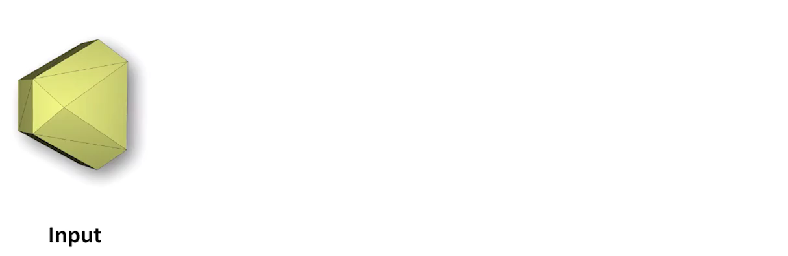
TetWild: Pipeline in 3D
TetWild Hu et al. 2018, SIGGRAPH 2018

Slide 14
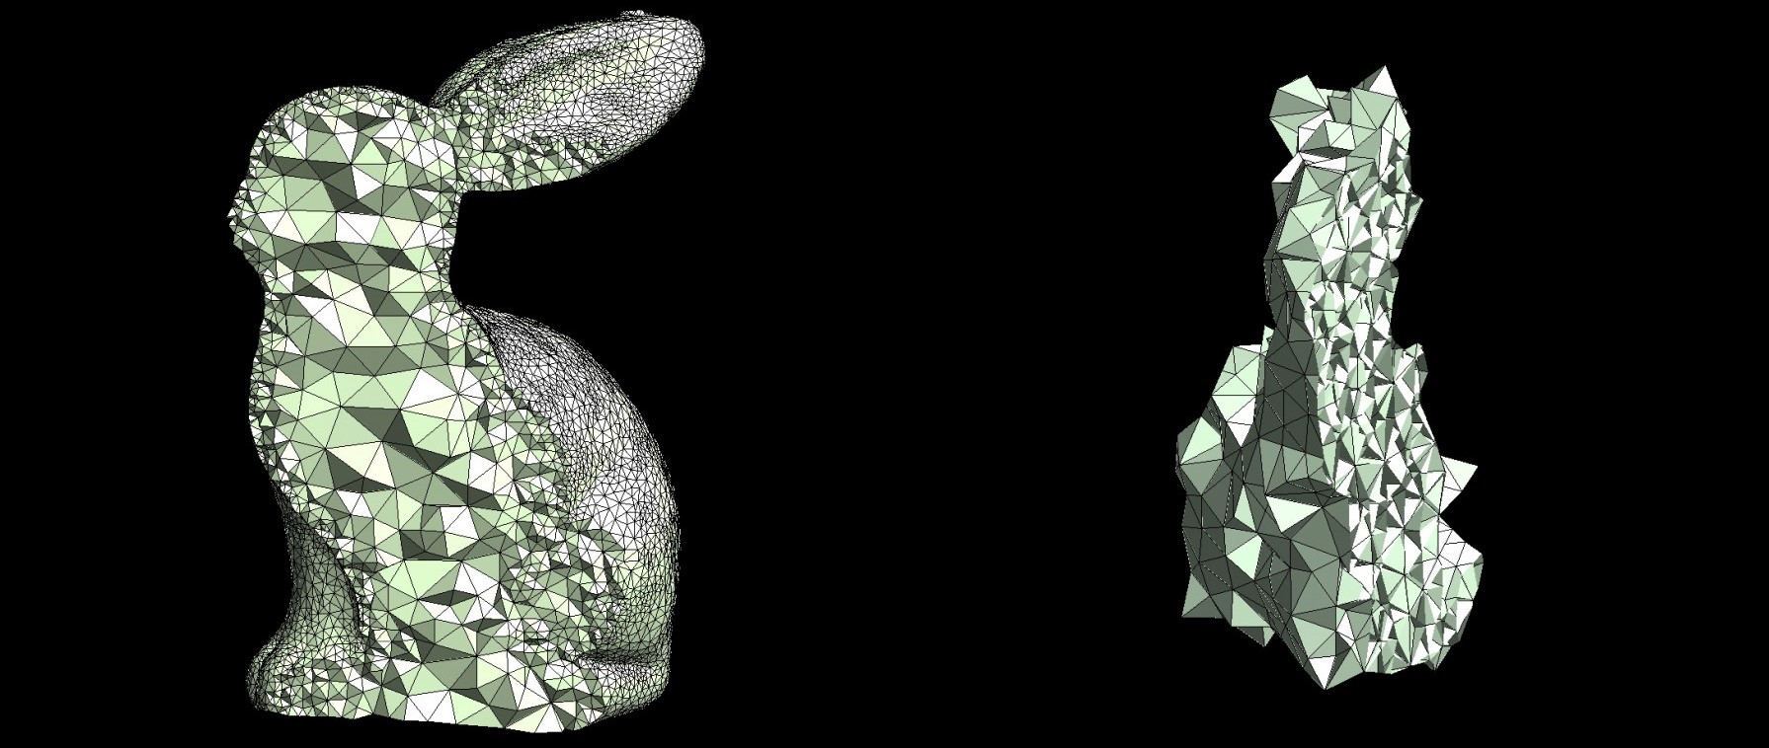
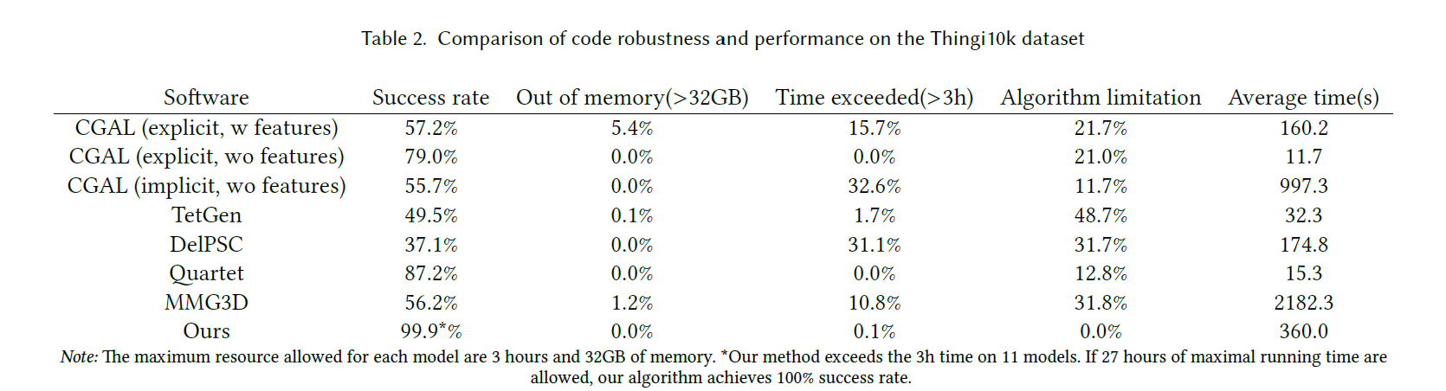
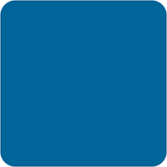
TetWild: Advantages
2 Parameters
Ideal Edge Length
Envelope Size (ε)
Default ε
High ε
Notes:
Easy to use. Needs two parameter:
1. ideal edge length: diag_of_bbox / 20
2. Envelope size. Smaller: better feauture preservation.
99.9 percent success rate when limited to 3 > hr and < 32 gb mem. 100 % if 27 hrs and < 1oo gb.
They have very interesting comparisons and visualization, so check them out if you are interested. Especially seeing the noise stress is quite impressive.
Method can be used for:
- surface repair
- cad models
- Structured meshing: quadmeshes,
- hexidral mesh or hex-dominant meshes
- when dealing with input boundary, the method allows smoothing to handle open regions
- meshing for multi materials solids
- multi component input
- works also well with thin surfaces

Slide 15
TetWild: Limitations
Notes:
- sharp features handled in a soft way. Balance between feauture preservation and robutsness, efficiency.
- for repairing method is limited to surface withouth large openings
- rational based comp. and envelope check is slow: but fast tetwild seems to adresss efficiency

Slide 16
Thank You for your Attention!
Don't forget to include a last slide that contains teaser images or a video or something else that reminds people about what you said.
It might well be that this slide will be on the screen during the whole discussion!

Slide 17
Thank You for your Attention!
Don't forget to include a last slide that contains teaser images or a video or something else that reminds people about what you said.
It might well be that this slide will be on the screen during the whole discussion!

Slide 18
Headline
Level 0
Level 1
Level 2
Hint: Do NOT use bullet lists wherever possible !!!

Slide 20
Sometimes a dark background is better. Use this template.

